Slide 1

ADAPTIVE WHEEL ALIGNMENT SYSTEM FOR VEHICLES
Group Suspenso
A.G.I. ISURANGA (E/20/154)
C.M.KEERTHISENA (E/20/198)
A.P. THILAKARATHNE (E/20/395)
E.M.I.U. WIJERATHNA (E/20/443)
Supervised by Dr D.H.S Maithripala
Department of Mechanical Engineering
Faculty of Engineering
University of Peradeniya
ME325- Mechanical Engineering Group Project
Proposal Presentation
May, 2025

Slide 2
Aim and Objective of the project
Aim
To create an adaptive wheel alignment system based on machine learning that changes the vehicle's wheel camber and toe angles in real time to enhance performance, safety, and stability while driving.
Objectives
To study the effect of camber and toe angles on vehicle stability and handling using real-world research and simulations.
Design a simulation-driven model for dynamic wheel alignment.
Integrate machine learning to predict optimal camber/toe angles.
Validate system performance across diverse driving conditions.
improve cornering grip, tire wear and fuel efficiency.

Slide 3

INTENDED LEARNING OUTCOMES
Technical proficiency in MATLAB Simulink, Carsim and ML algorithms.
Problem-solving skills in real-time vehicle dynamics.
Team collaboration and project management.
Learn project management skills, including task allocation and meeting deadlines.
Improve critical thinking through data analysis and system evaluation.
Critical analysis of simulation results.

Slide 4
INTRODUCTION
Problem
Passive alignment system lack adaptability to dynamic conditions (cornering, uneven roads).
Solution
Develop an ML-based system that adjusts camber/toe angles in real-time using sensor data (speed, steering input, tire temperature).
Scope
Simulation-only (CarSim/MATLAB) with potential for future hardware integration.

Slide 5
Methodology
Design Phase
Simulate vehicle dynamics in CarSim/Simulink.
Define ML model input (road conditions, vehicle states).
Implementing Phase
Training ML model on simulated datasets.
Embed model in Simulink for closed-loop control.
Testing Phase
Check ML model accuracy – Does it predict the best camber/toe angles?
Add control system – Test how the system adjusts the angles.
Full system test – Run everything together in CarSim and check how much vehicle stability improves.
Evaluating Phase
Compare results across CarSim, VI-CarReal and theoretical baselines.

Slide 6



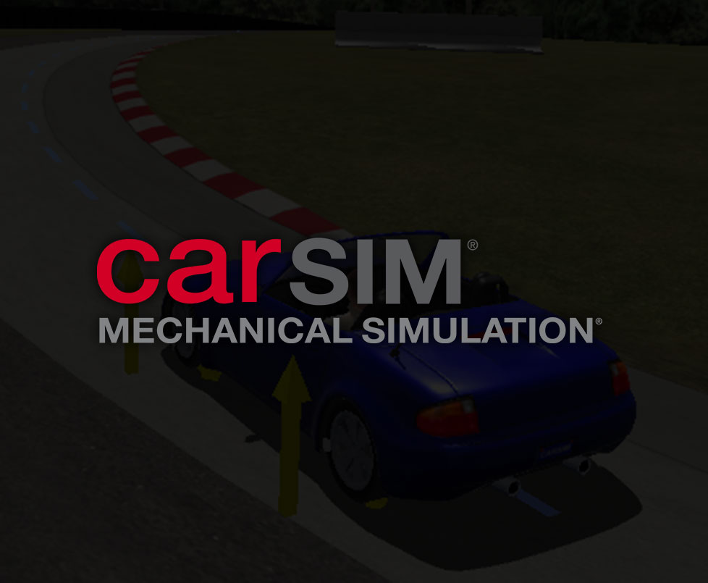
PROPOSED SOFTWARE
Matlab Simulink
CarSim
IPG CarMaker
VI-CarRealtime

Slide 7
TIMELINE
 | Task Description | Week
 |  | 1 | 2 | 3 | 4 | 5 | 6 | 7 | 8 | 9 | 10 | 11 | 12 | 13 | 14
1. | Selecting a Project Title
2. | Literature Review and Background Study
3. | Project Proposal Development & Presentation
4. | Learning Simulation Software
5. | Learning Machine Learning
6. | Gathering Datasets from Simulation
7. | Design & Development of Machine Learning Model
9. | Mid-evaluation Presentation
10. | Training the Machine Learning Model
11. | Testing and Validation
12. | Drafting Reports and Final Presentation
13. | Final Demonstration

Slide 8
REFERENCES
[1] Kavitha, C., Shankar, S.A., Karthika, K., Ashok, B. and Ashok, S.D. (2019). Active camber and toe control strategy for the double wishbone suspension system. Journal of King Saud University - Engineering Sciences, [online] Available at: https://www.sciencedirect.com/science/article/pii/S1018363917302799 [2] Yu, M., Evangelou, S. and Dini, D. (2023). Advances in Active Suspension Systems for Road Vehicles. Engineering, [online] Available at: https://www.sciencedirect.com/science/article/pii/S2095809923003983
[3] Balázs Németh and Péter Gáspár (2015). LPV-based Variable-Geometry Suspension Control [online] Available at: https://www.sciencedirect.com/science/article/pii/S2405896315023721

Slide 9


Slide 10
THANK YOU

